Slide 1


WELCOME
US Super Market Sales Analysis
Brahmajit Mohapatra
brahmajit2000@gmail.com
www.linkedin.com/in/brahmajit

Slide 2
Overview
This project is based on the Sales and profit received by a Super Market in USA
Aim is to derive different problem statements to get insights from the data using different graphs and statistical measures
The data consists of 24 columns and 9427 Rows.

Slide 3
Problems Statements
Name the top three states who have achieved highest profit ?
Name the top three states who have achieved highest sales ?
Which consumer segment needs more attention in terms of profit for the upcoming years?
Which consumer segment has an overall increasing trend in YOY sales and Profit?
Is there any specific trend that can be observed in the month wise profit?
Which year’s quarter can be termed as worst quarter in terms of profit?
Which years quarter do you think has performed the best?
Which product subcategories do the supermarket bears loss and need more attention?
Keeping 250 as benchmark on quantity sold, how many weeks there were deviations?
What is your observation on the type of customers of the Super Market?

Slide 4
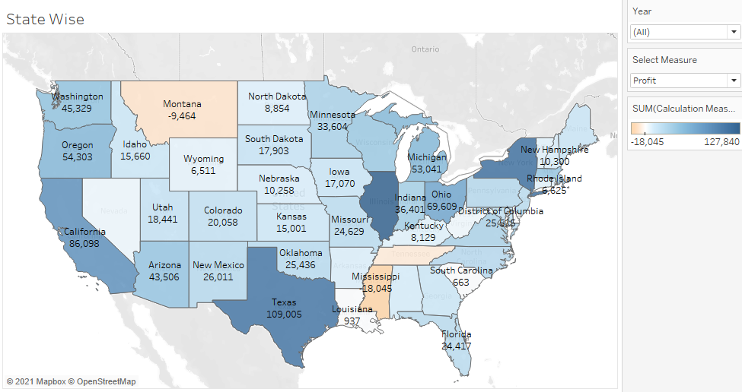
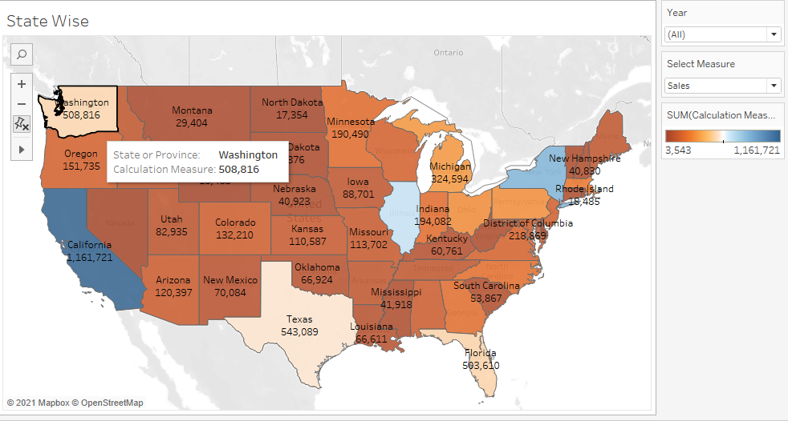
Problem Statement 1 & 2
Name the top three states who have achieved highest profit?
Name the top three states who have achieved highest sales ?
Highest Profit – Illinois, New york, Texas
Highest Sales – California, New york, Illinois

Slide 5
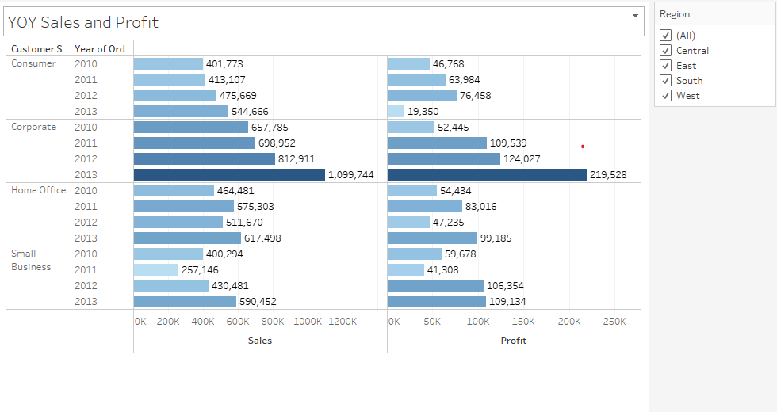
Problem Statement 3 & 4
Which Consumer Segment needs more attention in terms of profit for the upcoming years?
Which Consumer Segment has an overall increasing trend in YOY sales and Profit?
Need more attention on Consumer segment due to decrease in profit for the year 2013
Corporate segment has a overall steady increase in sales and profit from 2010 to 2013

Slide 6
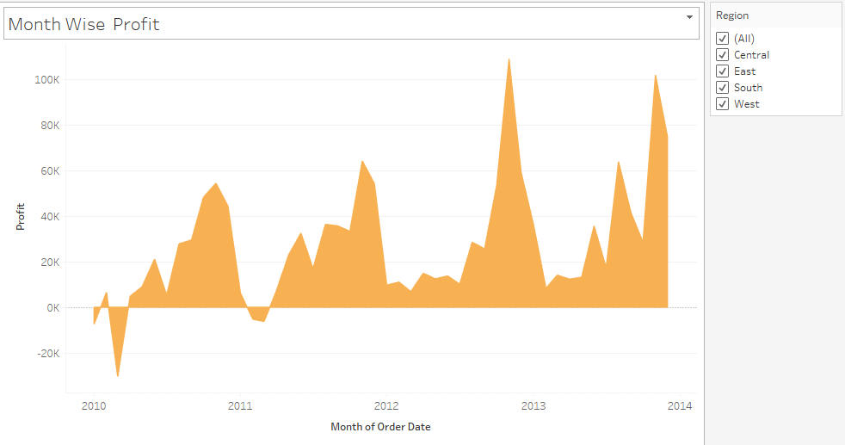
Problem Statement 5
Is there any specific trend that can be observed in the month wise profit?
November is the Month where the supermarket get maximum profit. After November, profit starts to slow down.

Slide 7
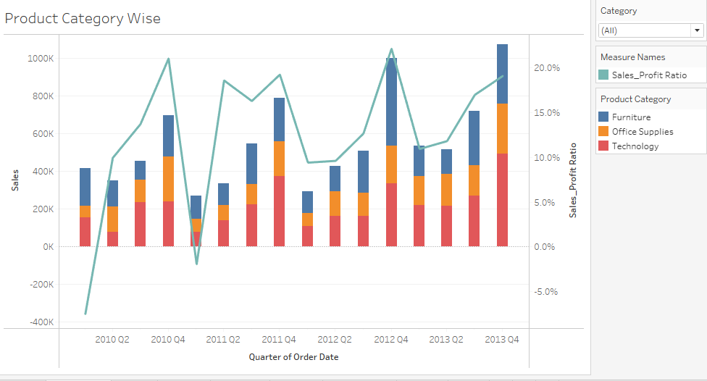
Problem Statement 6 & 7
Which quarter can be termed as worst quarter in terms of profit?
Which years quarter do you think has performed the best?
Worst Quarter 2010 Q1 – Due to lowest profit ratio when compared to sales.
Best Performing Quarter – 2012 Q4 due to highest profit ratio when compared to sales

Slide 8
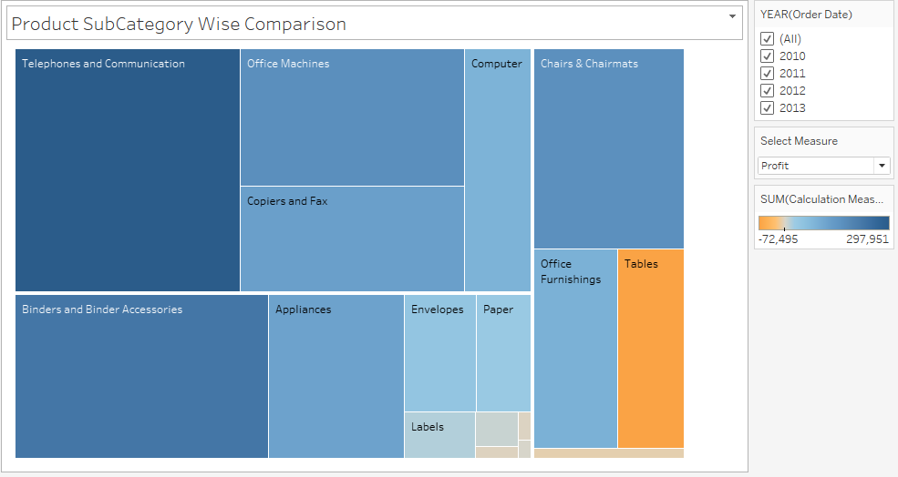
Problem Statement 8
Which product subcategories do the supermarket bears loss and need more attention?
Need attention on below categories. Supermarket bearing loss from the below items.
Tables
Bookcases
Rubber Bands
Scissors, Rulers and Trimmers

Slide 9
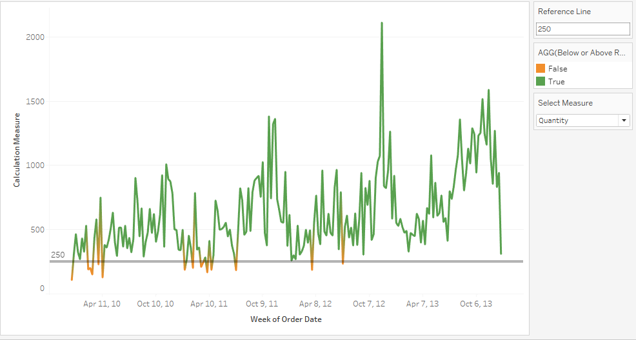
Problem Statement 9
Keeping 250 as benchmark on quantity sold, how many weeks there were deviations?
Using reference line in the chart, we were able to track around deviations in 12 weeks out of the benchmark

Slide 10
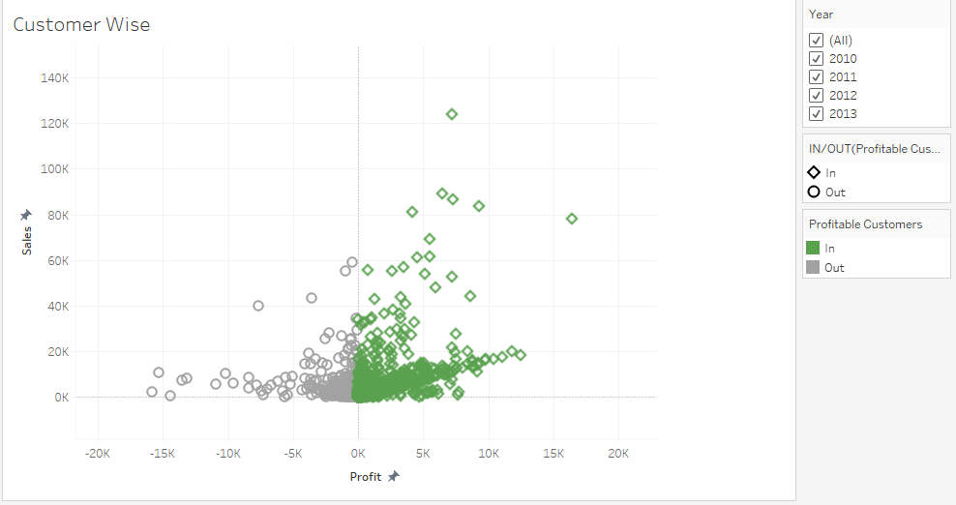
Problem Statement 10
What is your observation on the type of customers of the Super Market?
There are still many customer who are buying from the supermarket but we are unable to make out profit from them. Need to concentrate on those customers to change them to the profile of profitable customers.

Slide 11
CONCLUSION
States contributing to highest profit – Illinois, New york, Texas
States contributing to highest sales– California, New york, Illinois
Need more attention on Consumer segment due to decrease in profit for the year 2013.
Corporate segment has a overall steady increase in sales and profit from 2010 to 2013
November is the Month where the supermarket get maximum profit. After November, profit starts to slow down.
Worst Quarter 2010 Q1 – Due to lowest profit ratio when compared to sales.
Need attention on below subcategories. Supermarket bearing loss from the below items.
Tables
Bookcases
Rubber Bands
Scissors, Rulers and Trimmers
There are still many customer who are buying from the supermarket but we are unable to make out profit from them. Need to concentrate on those customers to change them to the profile of profitable customers.

Slide 12
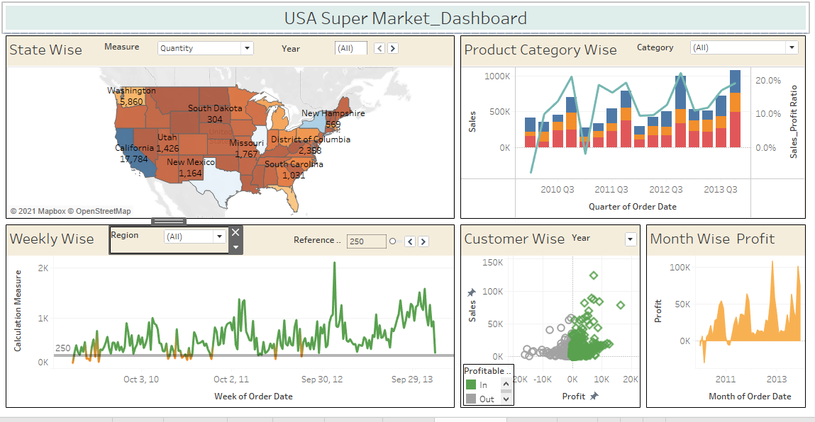
DYNAMIC DASHBOARD SNIPS

Slide 13

THANK YOU

